Slide 1


Forecasting Length of Hospitalization
Depi project

Slide 2
Outline
Introduction
Exploring the dataset
Data preprocessing
Exploratory Data Analysis (EDA)
Feature engineering
Modeling training
Conclusion

Slide 3
introduction
Predicting the length of a patient’s hospital stay is a key challenge in healthcare, impacting resource allocation and operational efficiency.
Hospitals often struggle to accurately forecast how long each patient will remain, leading to suboptimal use of resources.
This project uses clinical and diagnostic data to analyze and predict patient stay duration, helping healthcare providers optimize resource planning, reduce costs, and improve patient care.

Slide 4
Exploring the dataset
This dataset contains 100000 rows x 28 columns
Date, ID, and Demographics columns:
Eid: unique ID for each hospital encounter
vdate: date of visit
rcount: count of previous visits before this one (useful for patient chronicity)
gender
discharged

Slide 5
2. Binary columns:
dialysisrenalendstage: If patient has severe kidney disease (on dialysis).
asthma: If patient has asthma (lung disease).
irondef: Iron deficiency (likely anemia).
pneum: If patient has pneumonia.
substancedependence: Flag for drug/alcohol dependency.
psychologicaldisordermajor: Flag for major mental illness (e.g., schizophrenia, bipolar).
depress: If patient has depression.
psychother: Whether patient is receiving therapy.
fibrosisandother: Other lung-related disorders (e.g., fibrosis).
malnutrition: Flag for poor nutrition state.
hemo: Hemoglobin — related to oxygen in blood.

Slide 6
3. Numerical columns:
hematocrit: Hematocrit percentage.
neutrophils: Neutrophil count (type of white blood cell).
sodium: Sodium level in the blood.
glucose: Blood glucose level.
bloodureanitro (BUN): Blood urea nitrogen level.
creatinine: Creatinine level (kidney function).
bmi: Body Mass Index.
pulse: Heart rate.
respiration: Breathing rate.
lengthofstay: Length of hospital stay (target variable).

Slide 7
4. Categorical Columns:
secondarydiagnosisnonicd9: Secondary diagnosis information.
facid: Facility ID, which could be used for stratification or fixed effects.
Obviously, the target columns is lengthofstay, But the question is Which columns is important ? And which has the highest impact on the target ?

Slide 8

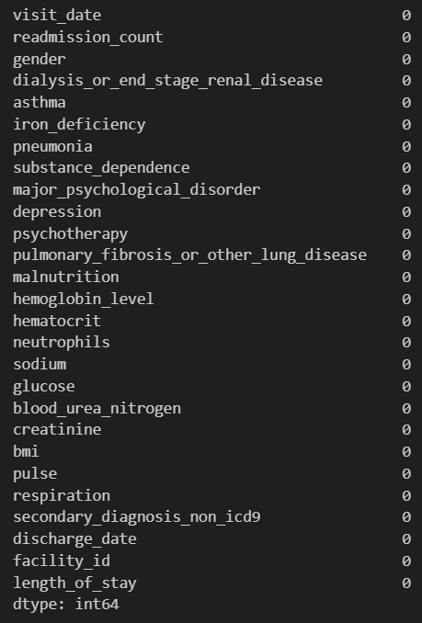

Data preprocessing
First drop (eid, discharged) because they aren’t useful and has no effect on the target
Check the null values as it’s shown in the figure 1 there isn’t any missing values
Then check for duplicate rows: there isn’t any duplicates
Now the data is ready for the EDA

Slide 9

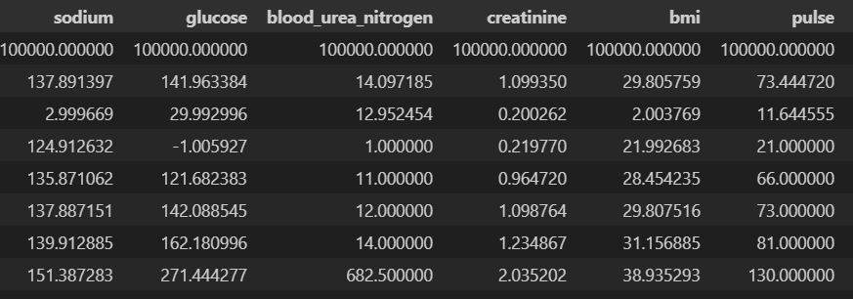
Exploratory data analysis (eda)
Overview of the description of the data we can find out that
Mean in (sodium, glucose, creatinine, bmi, pulse) is close to the 50% of the data that’s mean the data is normally distributed

Slide 10


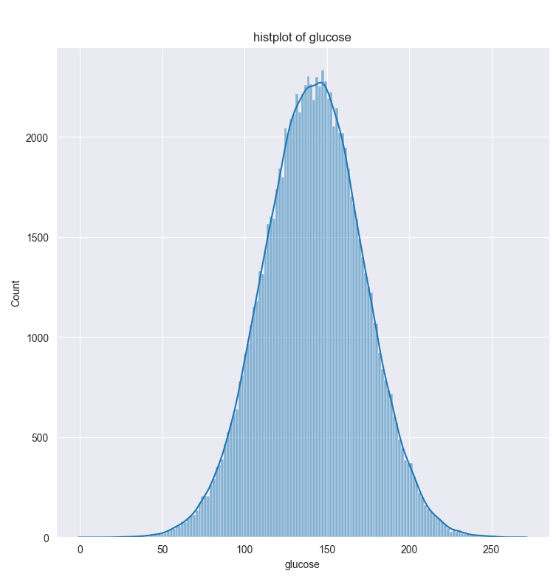

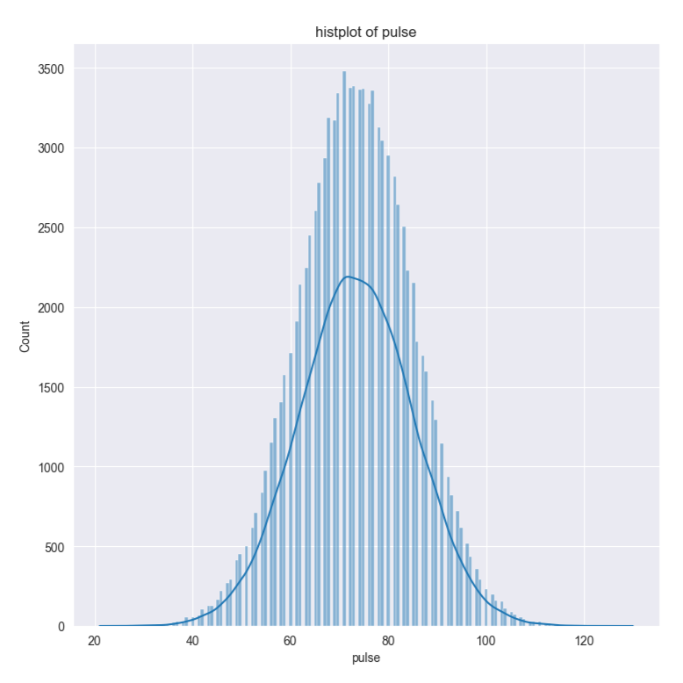
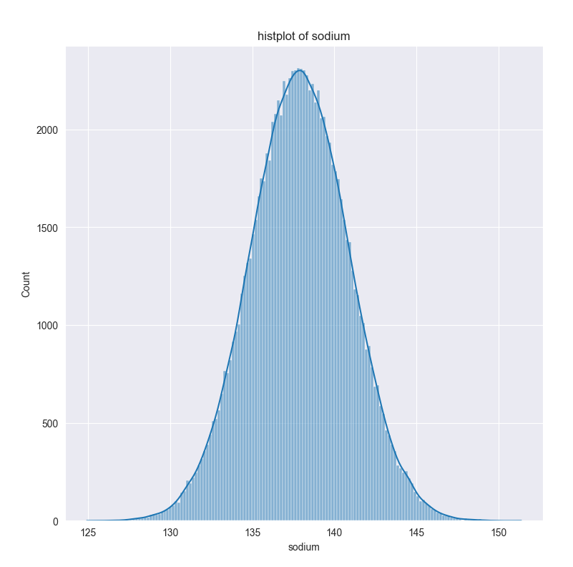
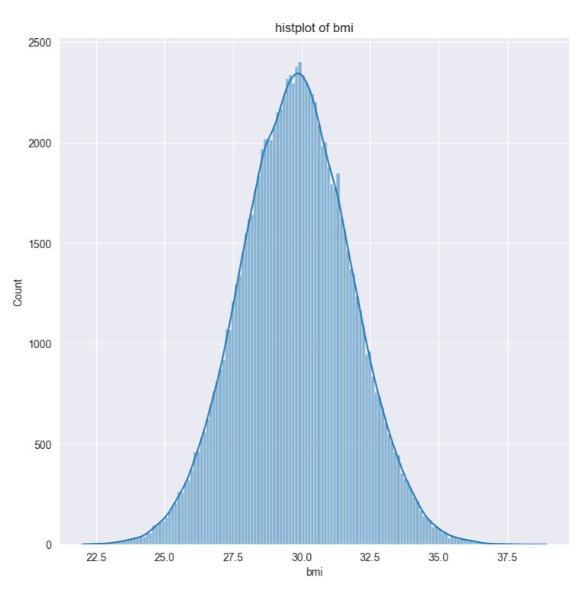
The histography shows that the (sodium, glucose, creatinine, bmi, pulse) columns are normally distributed.

Slide 11
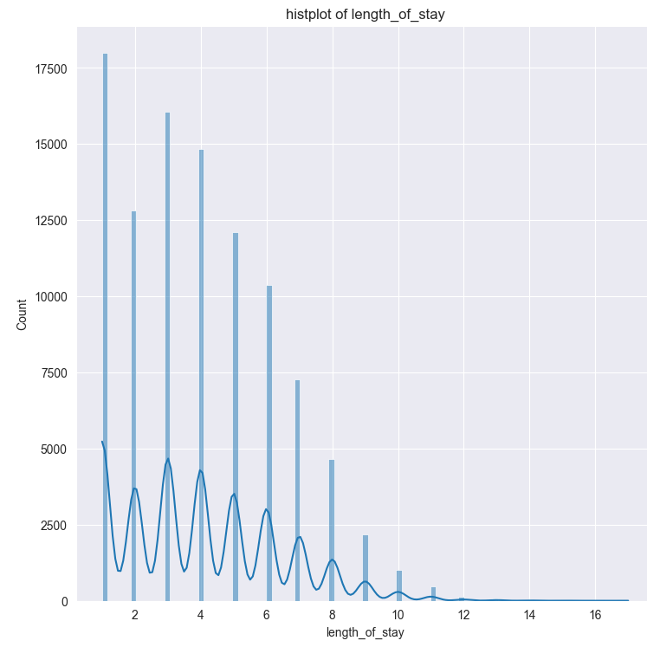
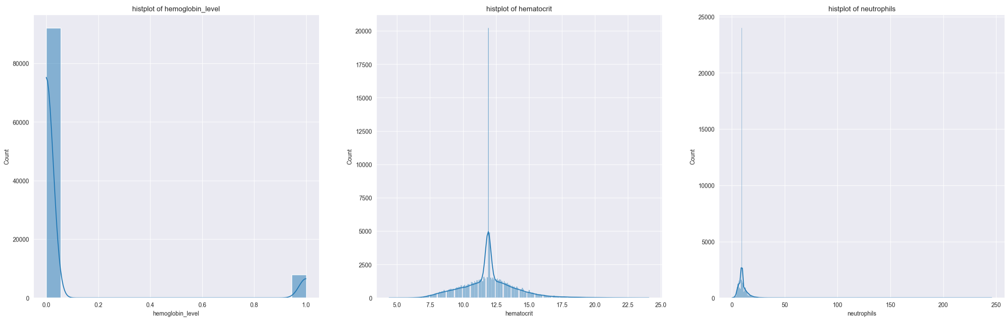
Most of the patients stays at the hospital in range (1 ,8) days
Despite having a lot of 11 value, hematocrit is still normally distributed enough
Most of the patients have normal level of hemoglobin in their blood around 9000 of them has abnormal

Slide 12
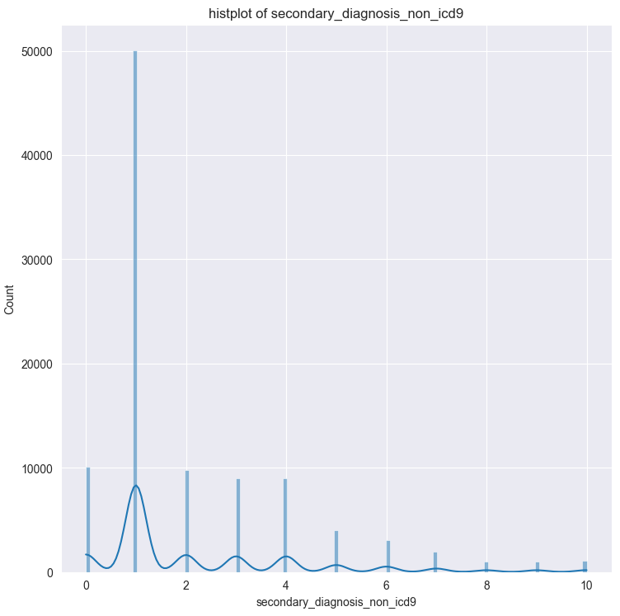
Icd9 is a global code for diseases
According to icd-9 2015 {1:cholera, 2: typhoid and paratyphoid fevers, 3: other salmonella infection, 4: shigellosis, 5: other food poisoning, 6: Amebiasis, 7:other protozoal intestinal diseases, 8: intestinal infections due to other organisms, 9: Ill-fedined intestinal infections, 10: primary tuberculous infection}
That means most of the patients is diagnosed with cholera, is second place nothing and typhoid and paratyphoid fever

Slide 13
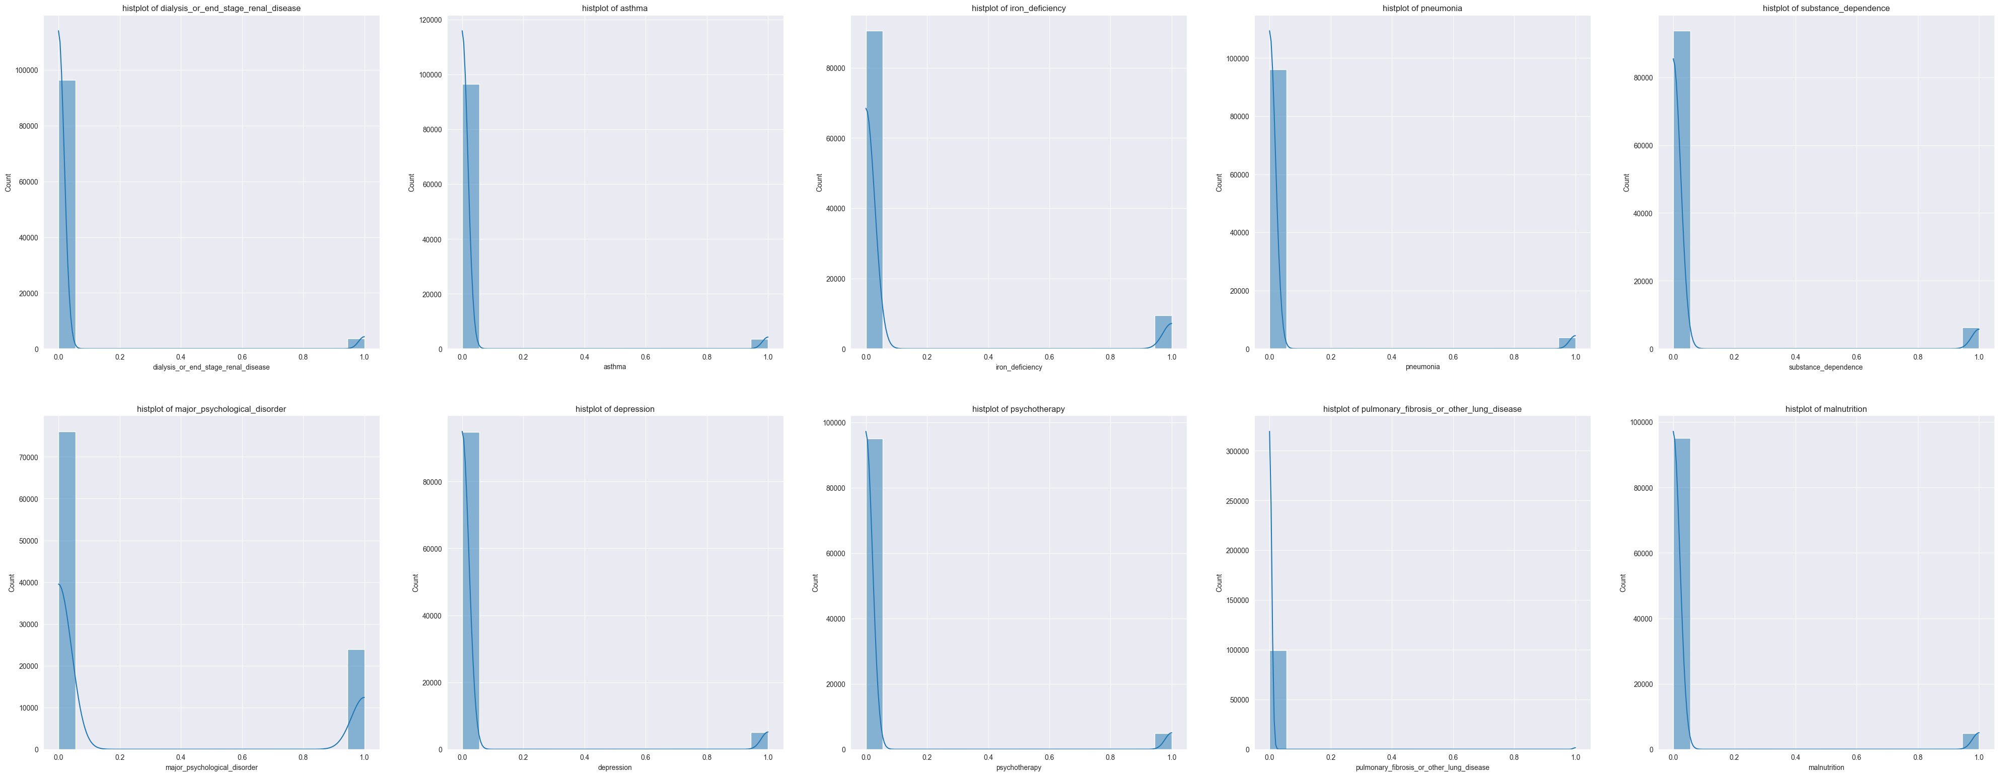
Based on the fact that hemoglobin levels is normal, the iron deficiency is normal too
The asthma has a lot of zeros so the lung disease most of it zeros too
Most of the patients don’t have any diseases so the dialysis or end stage renal disease most of it its no

Slide 14
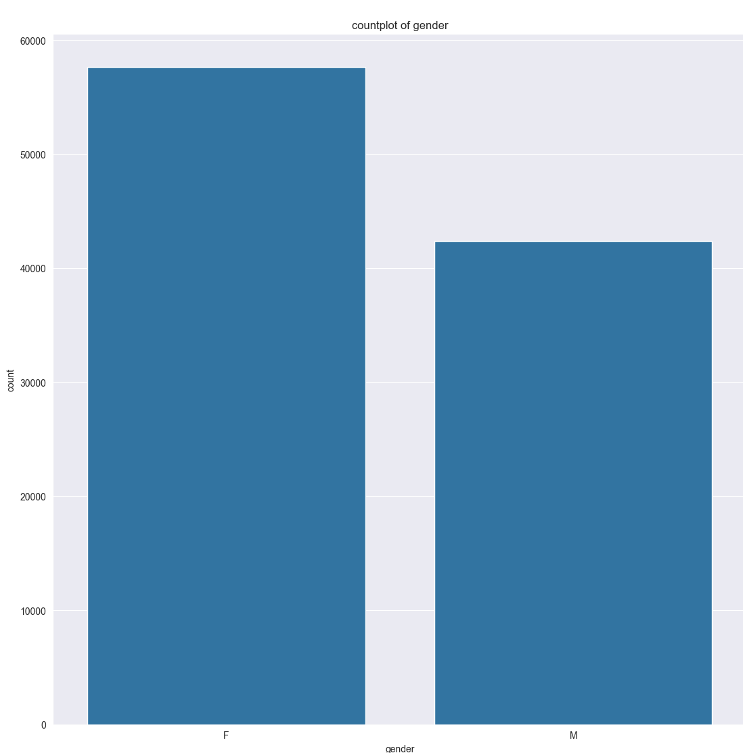
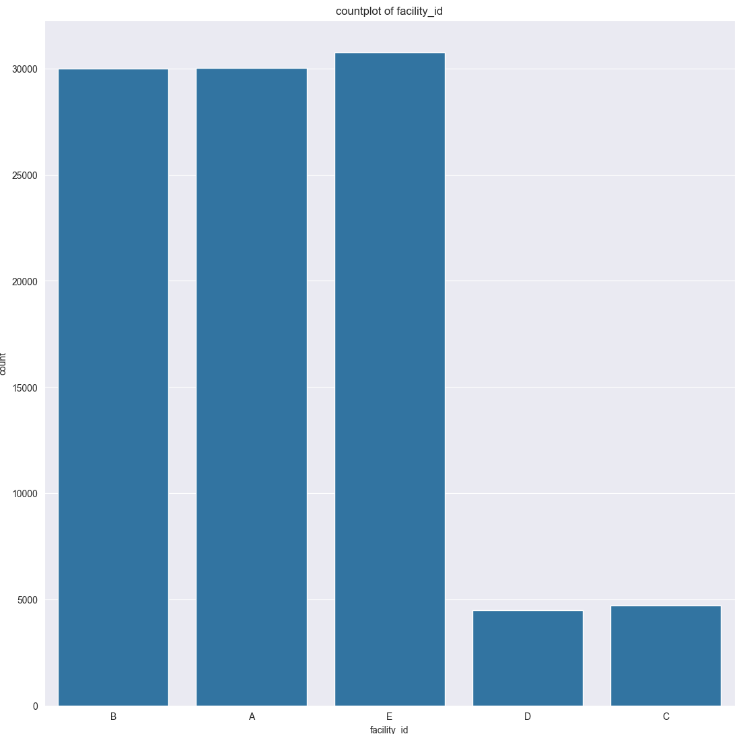
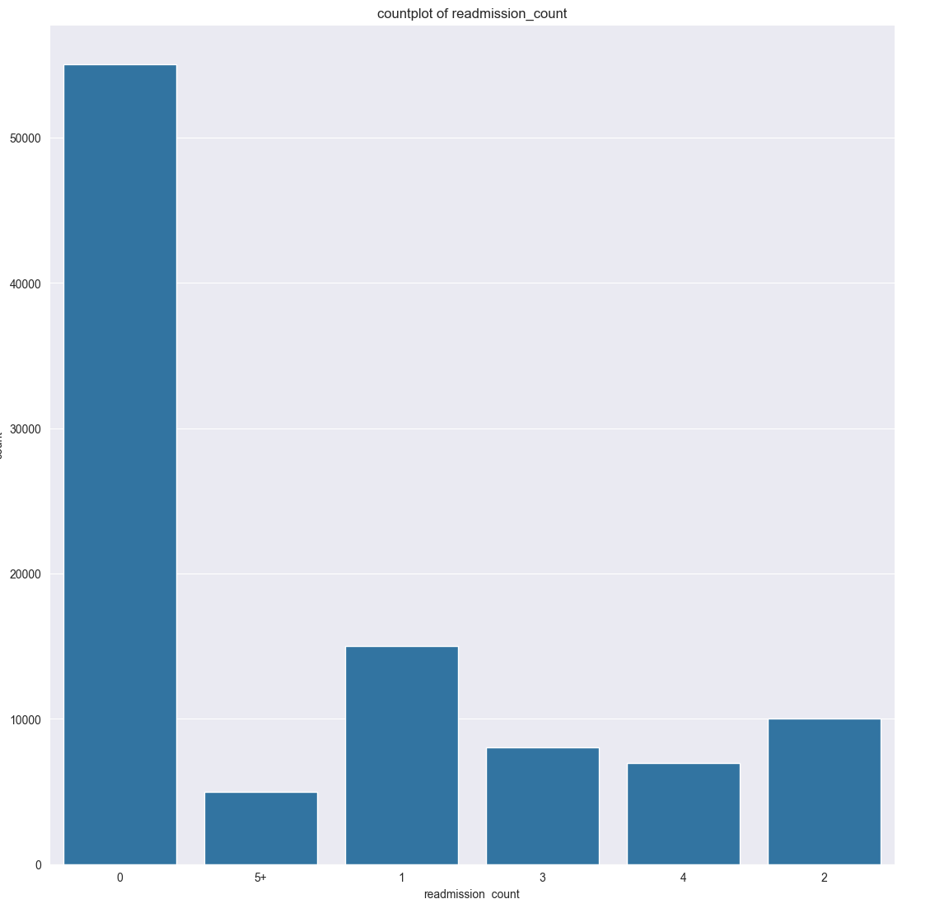
. There is more females than males . most of the patients are at (A, B, E) facilities . Most of the patient never came back readmission that means most of them doesn’t have chronic disease and that what has been shown earlier because most of the patients doesn’t have any diseases related to lung or blood disease .some patients came back once or twice that’s could be for doctor consultation, follow-up , or laboratory tests

Slide 15
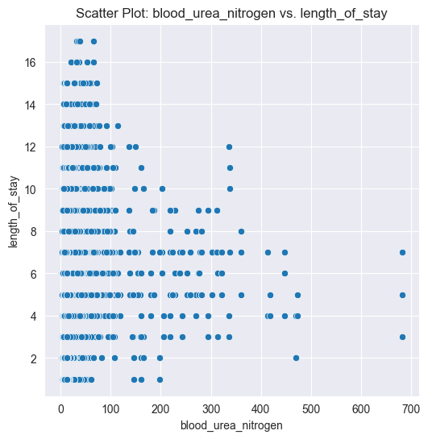
This scatter show nitrogen levels in plot for patients 0 to 90 low, 91 to 200 normal, 201 to 300 is abnormal, and over than that are high
High bun means kidney disease like (kidney failure, dehydration, heart failure, and high protein intake)
That means most of the patients aren’t staying for kidney diseases

Slide 16
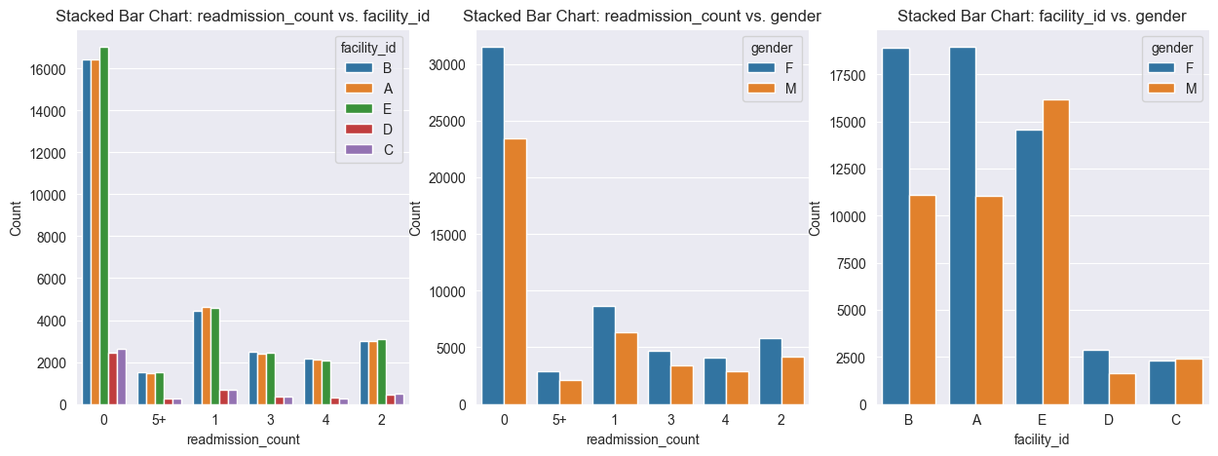
The data was biased for B,A,E facility so the majority is biased to for it
A study published in the Journal of Women's Health found that women are often more proactive in seeking medical attention and following up with their healthcare providers after initial hospital visits. That could be the reason why most of the dataset is females

Slide 17
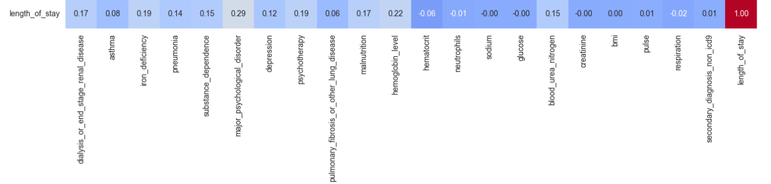
Correlation:
It shows weak correlation between all the columns and the target

Slide 18
Feature engineering
Handling categorical columns: (visit_date, readmission_count, gender, facility_id)
Gender: encoded to 1 male, 0 female
Readmission: 5 and values bigger than 5 to 5+ else leave it as its.
Visit Date: it holds more than just calendar info. We extract season and apply cyclical encoding to capture time-related patterns like seasonal illnesses or weekday effects. This columns now has the 4 seasons and sin, cos days and months.
Facility Id: using get_dummies function it encodes to one-hot encoded columns values (0,1)

Slide 19
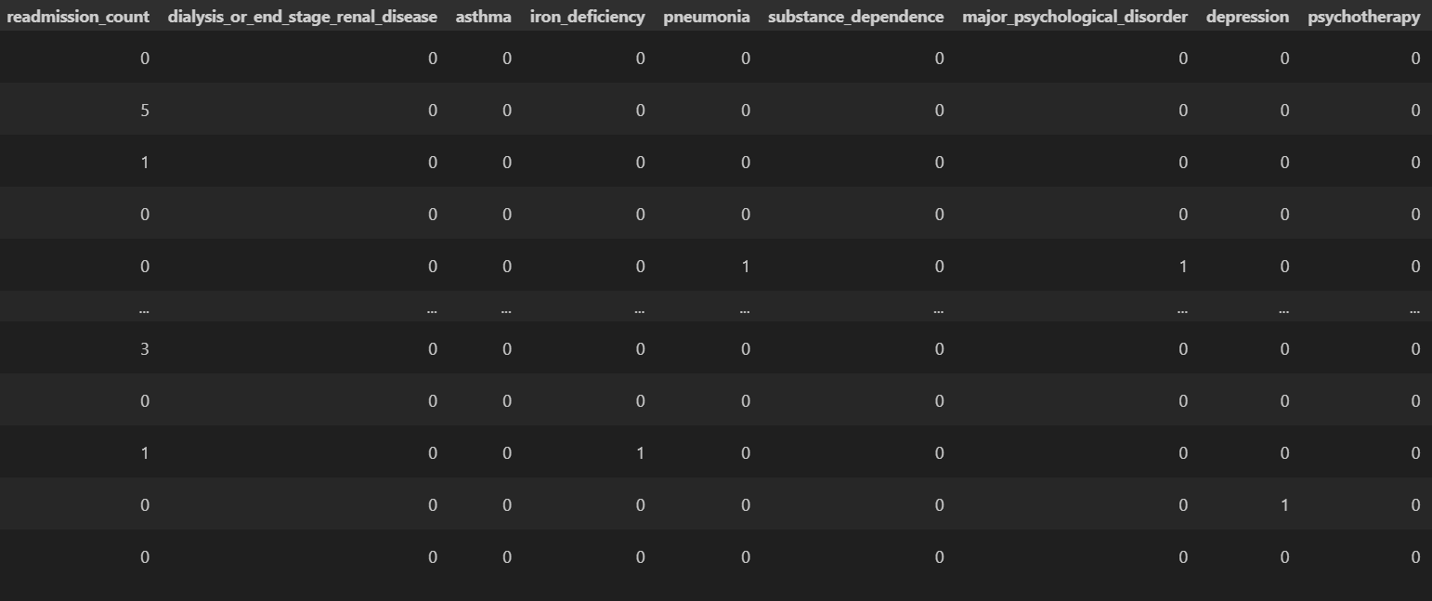
The dataset is something more like that

Slide 20
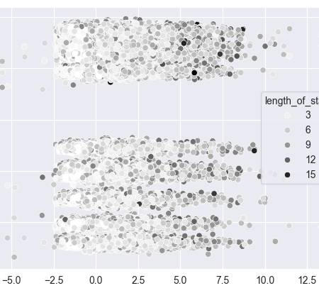
5. PCA: Reduce the scaled features set to 2 components to capture the most important variance in the data using just 2 dimensions

Slide 21
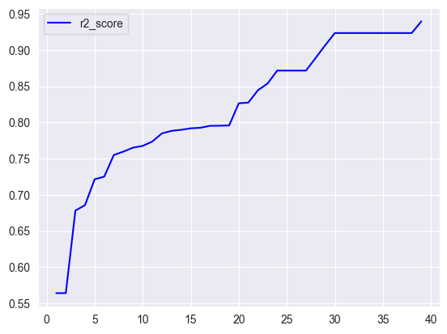
Feature selection:
Selectin the best subset of features for predicting the target variable using lightGBM regression model.
Training the model with different numbers of features and evaluating performance using R2 score.
The optimal number of features that yield the highest predictive accuracy reduce complexity while maintaining performance
(Higher R2 means better model)
7. Save the dataset

Slide 22
Model training:
X or the independent variable is all columns except the length_of_stay
Y is length_of_stay
Split the data 80% to train and 20% test that’s give the model data to train on and ensure the model isn’t overfitting
The target is categorical so using models like trees and knn is better answer

Slide 23
Accuracy measures
Metric | Measures | Ideal Value | Interpretation | Description
R² | Variance explained by the model | 1 | Higher is better | Shows how well predictions match actual outcomes on average
MSE | Mean of squared prediction errors | 0 | Lower is better | Penalizes larger errors more heavily, making it sensitive to outliers
MAPE | Mean absolute percentage error | 0 | Lower is better | Expresses error as a percentage; unstable when true values are near zero
CCC | Concordance correlation coefficient | 1 | Higher is better | Reflects both precision and accuracy (how close predictions follow true values)
Max Diff | Maximum absolute prediction error | 0 | Lower is better | Measures the single largest deviation between prediction and actual value

Slide 24
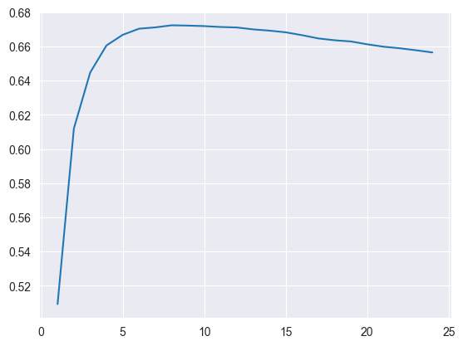
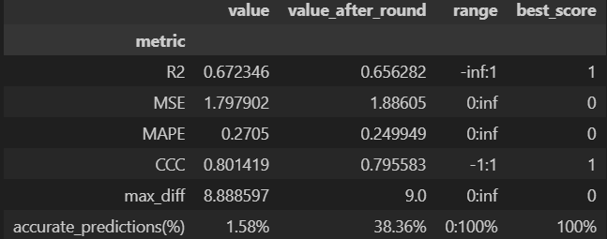
Knn Regressor
Knn: ML algorithm that predicts values based on the closest data point in the training set
Knn regressor: loops through values of k fits the model, predicts, evaluates and tracks the best resualt based of R2 score. The optimal k is the one the with highest R2 score

Slide 25
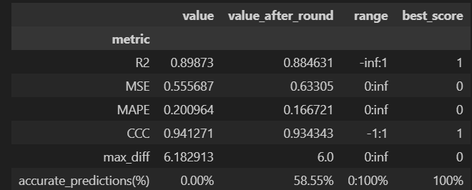
Random forest regressor:
Random forest: is an ensemble learning algorithm that builds multiple decision trees and combines their results to improve accuracy and reduce overfitting
It shows better R2 than knn and that’s predicted due to random forest is better when dealing with weak correlation

Slide 26

Svm regressor
SVM Regressor: fits a function within a margin (ε) around the true values and aims to keep it as flat as possible.
Best for small to medium datasets, sensitive to feature scaling and parameters.
Kernenl (type of decision boundary): linear, poly, rbf, sigmoid
C: the higher fit the data more closely
Gamma: how fare the influence of the single point reach
It has lower R2 than random forest and worest mse

Slide 27
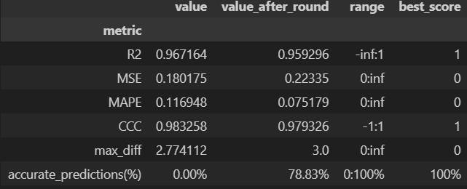
XgBoost regressor
XGBoost is a fast and scalable gradient boosting algorithm used for classification and regression. It builds trees sequentially, correcting previous errors while controlling overfitting with regularization.
Key hyperparameters:
n_estimators: Number of trees
learning_rate: Step size
max_depth: Tree depth
subsample: Data fraction per tree
colsample_bytree: Feature fraction per tree
It has better accuracy due to its gradient boosting approach and regularization to handle better the overfitting

Slide 28

Lightgbm regressor
Fast and efficient gradient boosting algorithm for regression tasks.

Slide 29
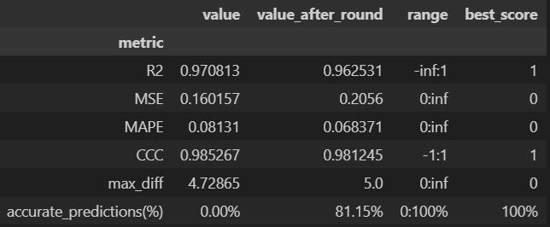
stacking
is an ensemble learning technique where multiple are trained to solve the same problem, and their predictions are combined to make a final prediction. The idea is to leverage the strengths of different models.

Slide 30
comparison
Model | Strengths | Weaknesses | Best Use Case
KNN (K-Nearest Neighbors) | Simple, intuitive, no training phase. | High memory usage, slow for large datasets. | Small to medium-sized datasets with simple patterns.
Random Forest | Robust to overfitting, handles missing values. | Can be slow with large datasets, less interpretable. | Large datasets with complex patterns, high variance.
SVM (Support Vector Machine) | Effective for high-dimensional data, works well with a clear margin of separation. | Computationally expensive, sensitive to noisy data. | High-dimensional spaces, binary classification.
XGBoost | Fast, accurate, handles missing values, regularized. | Prone to overfitting without tuning. | Complex datasets with non-linear relationships.
LightGBM | Very fast, efficient with large datasets, handles categorical data. | May overfit with very small datasets. | Large datasets with categorical features.
Stacking | Combines strengths of multiple models, usually gives better performance. | Requires careful model selection, complex to implement. | When you have diverse models and want better performance.

Slide 31
Conclusion
According to the last comparison and the accuracy result is shows that starting from the xgboost the model gets higher score that’s because the type of the data it has high dimensionality, complex and has weak correlation

Slide 32
Thank you

